Slide 1
Simulating Natural Selection
Govind G S
ME21B065
ID5090 final project

Slide 2
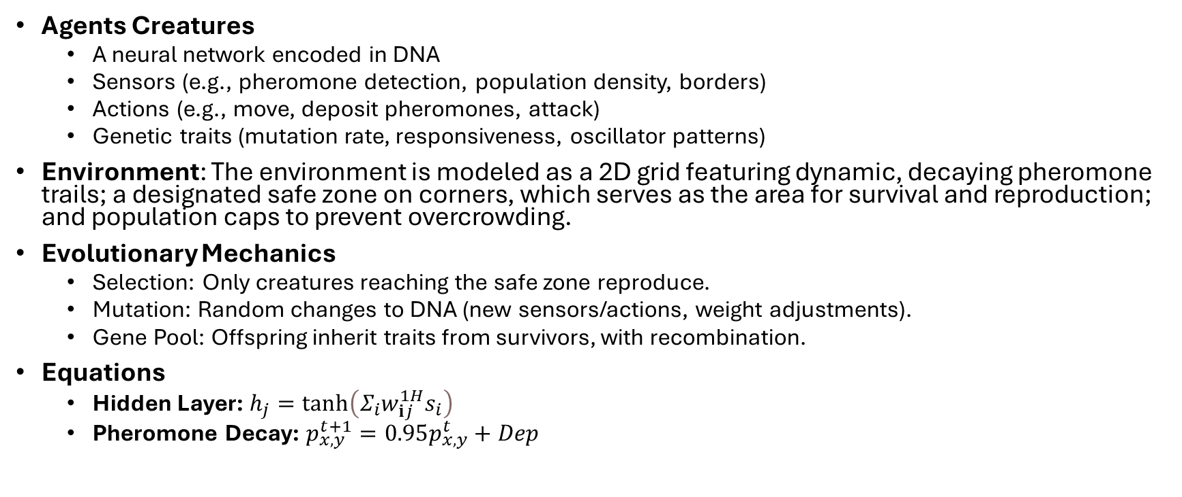
System & equations
Agents Creatures
A neural network encoded in DNA
Sensors (e.g., pheromone detection, population density, borders)
Actions (e.g., move, deposit pheromones, attack)
Genetic traits (mutation rate, responsiveness, oscillator patterns)
Environment: The environment is modeled as a 2D grid featuring dynamic, decaying pheromone trails; a designated safe zone on corners, which serves as the area for survival and reproduction; and population caps to prevent overcrowding.
Evolutionary Mechanics
Selection: Only creatures reaching the safe zone reproduce.
Mutation: Random changes to DNA (new sensors/actions, weight adjustments).
Gene Pool: Offspring inherit traits from survivors, with recombination.
Equations
Hidden Layer: $h_{j}=\tanh\left(Σ_{i}w_{ⅈj}^{1H}s_{i}\right)$
Pheromone Decay: $p_{x,y}^{t+1}=0.95p_{x,y}^{t}+Dep$

Slide 3
Interplay of Genes to reach Safe-Zone
The most common genes found:
Lx-1-LPD
Lx-1-Mfd
BDx-0-MY
Explain what the data is:
X-Axis–Driven Exploration: strategy to navigate safely away from center toward corner
Moves in random and forward once reaching the side edges in an attempt to reach corners
Visualizing the last generation creatures movements we can verify our understanding of the gene working
What we learned
Dominant circuit emerges which explains the observed action of the creatures
edge-seeking + vertical randomization is the most viable survival strategy given the gene size in DNA

Slide 4
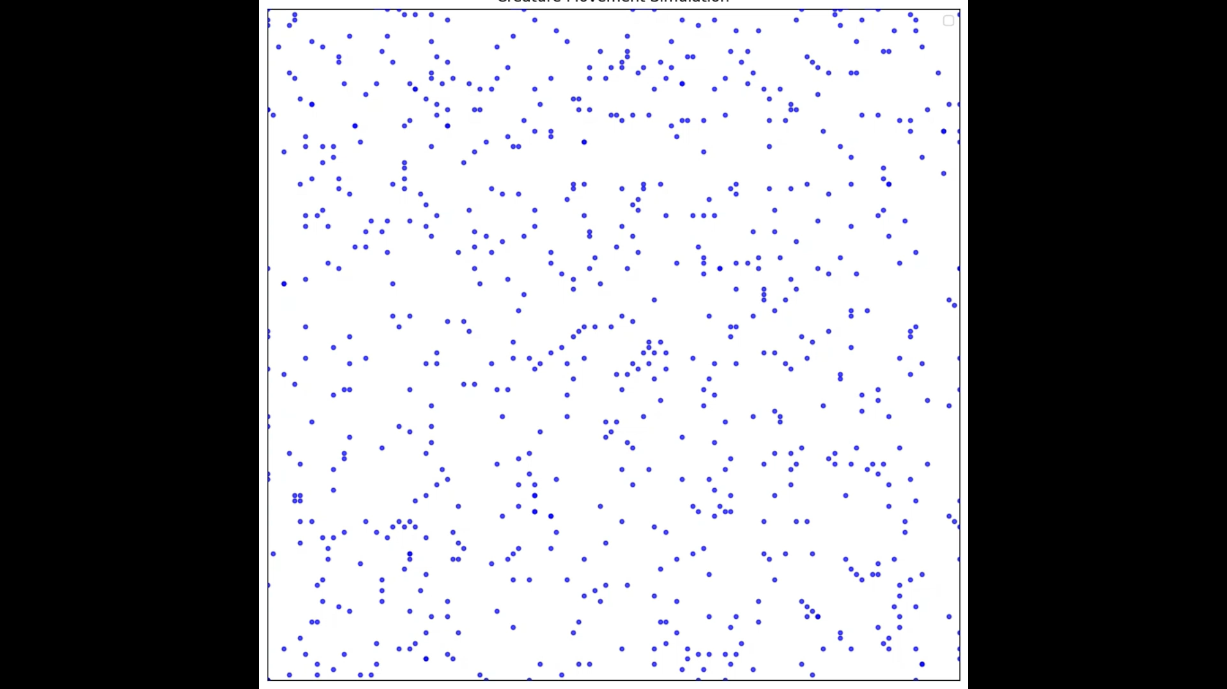
Interplay of Genes to reach Safe-Zone

Slide 5
Pheromone Gradient
The presence of the genes:
3-SG
Sir-4
Sfd-4-Mfd
Explain what the data is:
Pheromone gradient is deposited by some creatures and picked up by other creatures and used to move forward
We can visualize this with the help of heat map of pheromone deposition
Simple local rules yield a collective routing network, increasing travel success

Slide 6
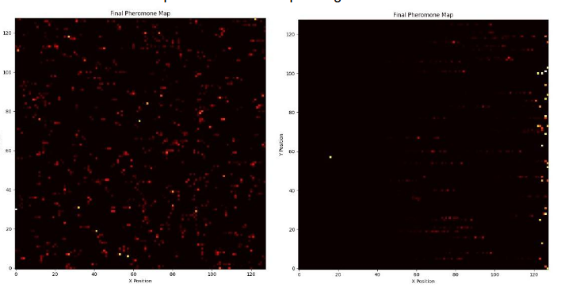
Pheromone Gradient
Initial and Final Pheromone Heatmap

Slide 7
New questions to ask in the system
New Research Worthy Questions
How do different geometries and placements of safe zones influence evolutionary pressure and survival strategies
What new behaviors emerge when expanding the set of sensor and action genes in the DNA
How different environment conditions will affect the outcome of the simulation (walls, stop/increase mutations)
How does initial genetic diversity affect evolutionary outcomes
Why these questions matter
Adaptation Analysis: Helps explore how structural changes in the environment drive diverse evolutionary paths
Scalability: Assesses the limits of the sensor-action framework and neural processing model
Synthetic Biology: The patterns of evolution and survival in the simulation provide a blueprint for engineering biological systems
By asking these questions, we see how evolved creatures discover novel ways to navigate and solve challenges in their environment

Slide 8
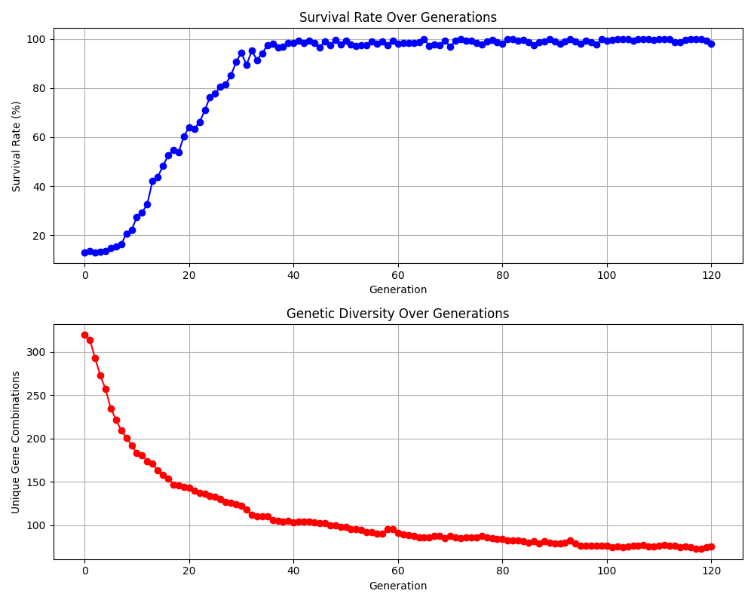
Survival Rate and Genetic Diversity with Generation

